Slide 1
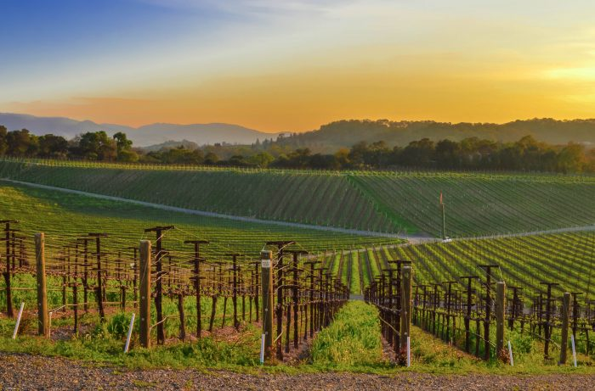
The Impact of a Changing Climate
on the California Wine Industry
Eric Blanchard, Jason Elder, Montana Janssens, Ma Khristina Yagin
Notes:
Photo source

Slide 2
Research Questions:
Will the top five counties for 2020 in wine production continue to be the most profitable over the next 10 years based on trends from the last 40 years?
Is there a correlation between weather of a given year, wine production, and profitability?
How have shifting climate patterns impacted the wine industry in California?

Slide 3
Data Used
Weather metrics, per county, per year
Minimum temperature (F)
Maximum temperature
Average temperature
Temperature range
Precipitation (inches)
Wine metrics, per county, per year
Harvested Acres
Yield (ton per acre)
Production (tons)
Price (dollars per ton)
Value (dollars)

Slide 4
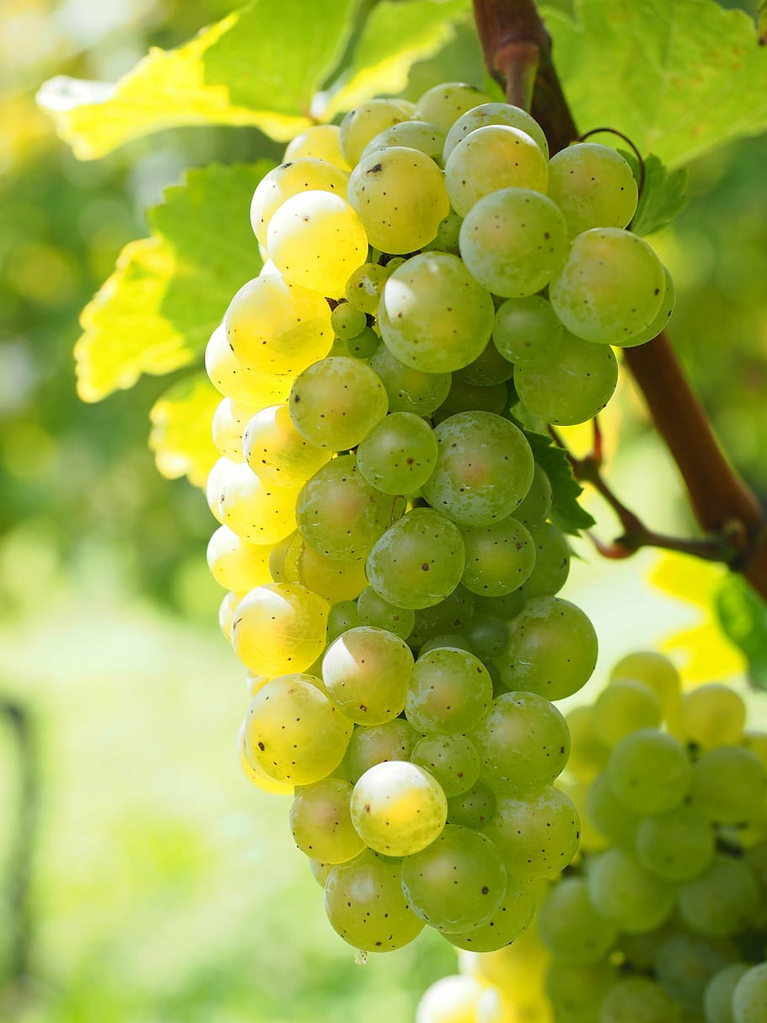
Wine in California:
California has been producing wine since 1608
Produces 90% of America’s wine supply
4th largest wine producer among the world’s independent nations
Has more than 4200 wineries that distribute internationally
Cabernet Sauvignon & Chardonnay
Notes:
California wine production has a rich viticulture history since 1680. Known for its sweet, port-style and jug wine products. California’s table wine business grew modestly and quickly gained internationally.
The state produces about 90% of the American wine supply and is the 4th largest wine producer among the world’s independent nations.
California has more than 4,200 wineries with international distributions.

Slide 5
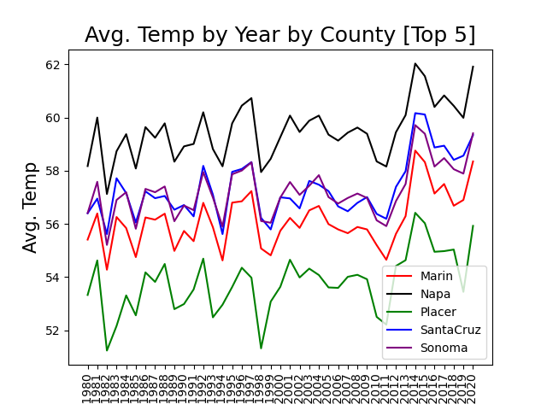
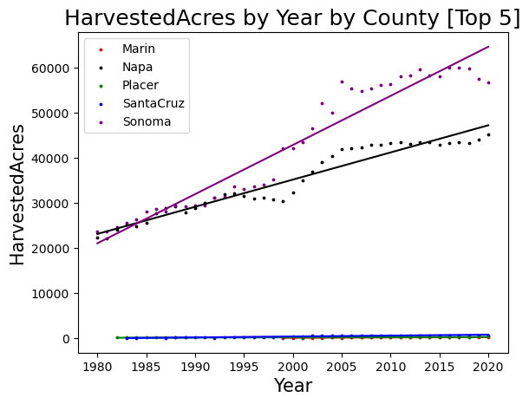
Average Temperature and Number of Harvested Acres 1980-2020
Notes:
Temperature is in Fahrenheit and units are Tons for all our graphs.
This here is a simple overview of some weather and productivity information of our 5 counties. Just to reiterate the 5 are Marin, Placer, Santa Cruz, Napa, and Sonoma. We can see that despite these five counties being the top players in 2020, we can see that there are clear differences between Sonoma/Napa ( shown on the right in Black and Purple) as compared to the other 3. And while average temp is and important metric for vine health…. Max temp is more important in grapevine health and greatly impacts production can be seen on the next slide.

Slide 6

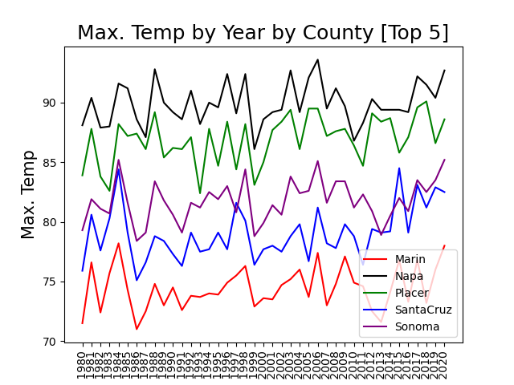
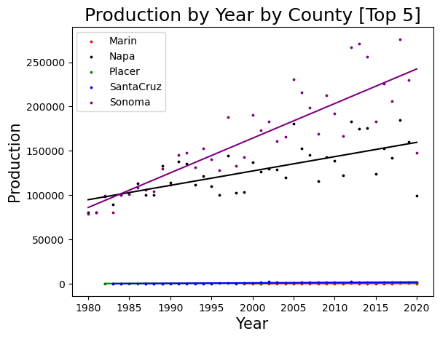
Temperature factors
Notes:
Grapes thrive when the temperature is between 77 and 90 degrees. Above 90 is harmful to the grape and can negatively impact the flavor profile of the wine. We can see on the left that Napa has experienced more 90+ temperatures than other areas of interest. The yearly average temperatures have also been steadily increasing ( as seen on the previous slide) . This increase in temperature may be beneficial to Santa Cruz and Marin and bring these areas into prime growing conditions, but may be have negative effects on other regions. We can also see that sonoma county, (which maintains similar status as napa in production and price as compared to the other counties) is increasing production by a greater degree. For Napa, there may be beneficial short term economic impacts due to these high temperatures, despite it having negative effects on wine quality and long term productivity.

Slide 7

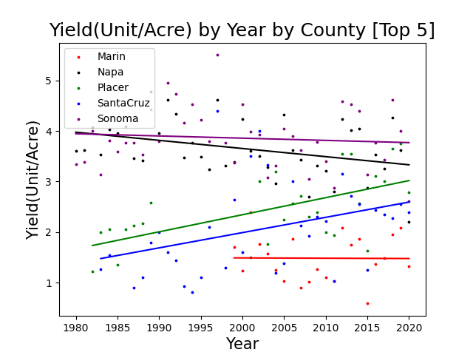
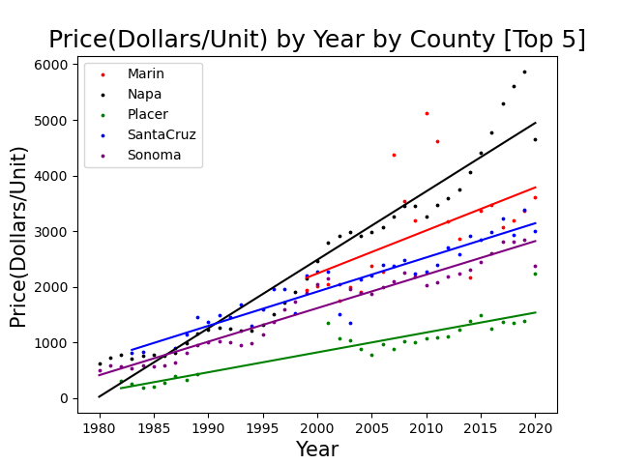
Yield and Prices
Notes:
The increased productivity that results from a beneficial increase in temperature can be seen in the figure on the left with measures the productivity of the land. We can see that the only county with a negative slope is also the one experiencing the most 90 + temperature spikes. (Napa) On the other hand a decrease in supply due to lower productivity that comers with hot temperatures ( coupled with a growing or steady demand for california wines) may lead to an increase in prices as seen on the right, these are the short term gains from a decrease in supply due to temperature over 90 degrees.
In short, Napas weather is pushing above the threshold of 90 degrees which is decreasing yield and in for now that might be bringing about greater prices but in the long run may not be good for the counties wineries.

Slide 8
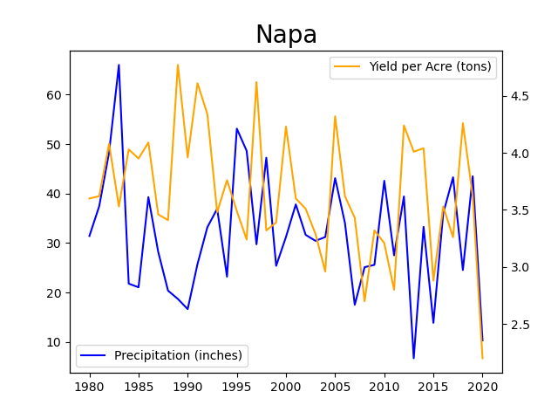
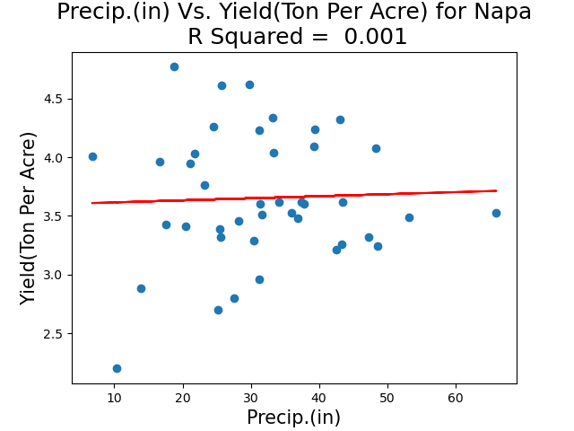
Precipitation and Yield in Napa
Notes:
Since we know that weather factors do influence crop yields, we concluded that our dataset was too small to see the correlations that might actually be present.
We had weather data that was monthly, but our wine metric data was only yearly, so we aggregated our weather data into yearly metrics to look for correlations between the two. When we look at the yearly data plotted on the left, we can see that the maximums and minimums of the precipitation and yield graphs match in certain places and oppose each other in others. When we look at a linear regression of the precipitation plotted against the yield, we don’t see a correlation. This is true for all counties, for all metrics that were present in our dataset.

Slide 9
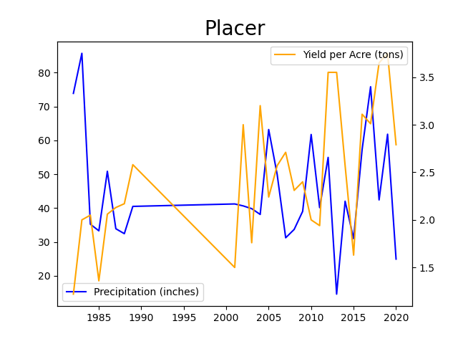
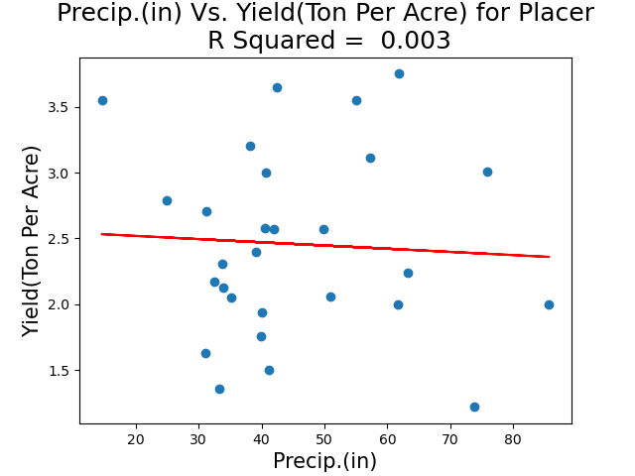
Precipitation and Yield in Placer

Slide 10
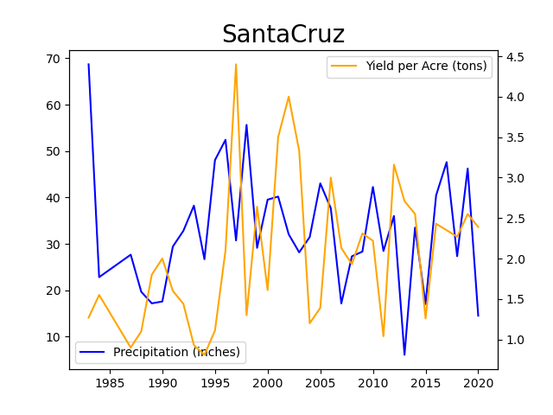
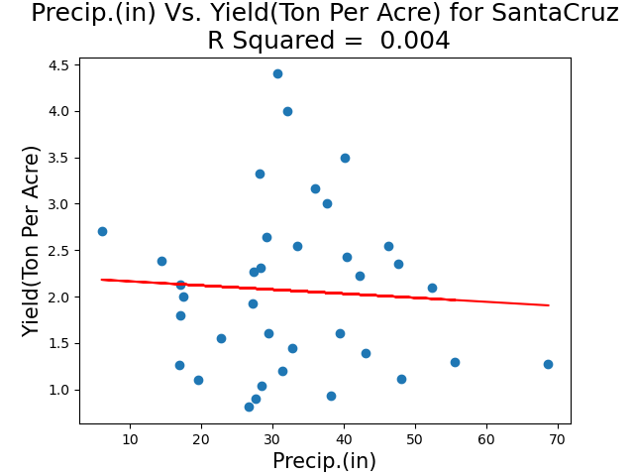
Precipitation and Yield in Santa Cruz

Slide 11
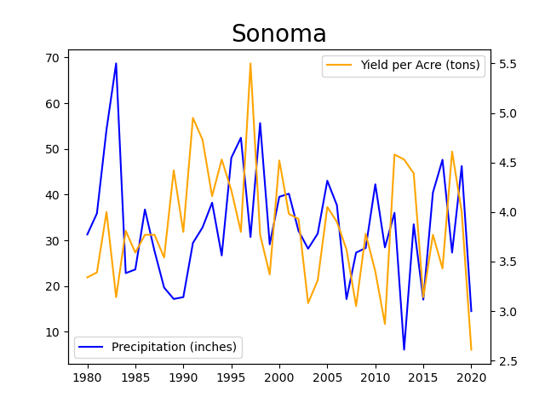
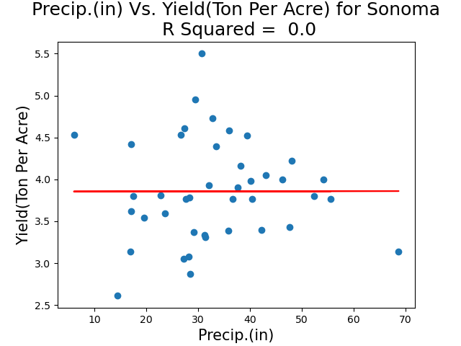
Precipitation and Yield in Sonoma

Slide 12
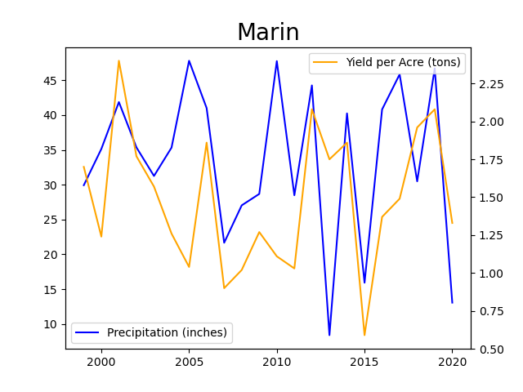
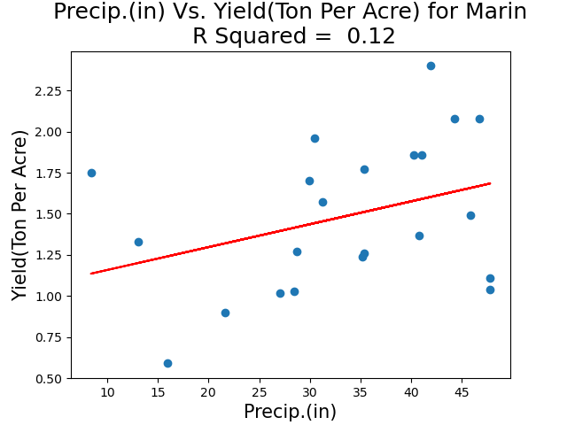
Precipitation and Yield in Marin
Notes:
When we look at the yearly data plotted on the left, we can see that the maximums and minimums of the precipitation and yield graphs match in certain places and oppose each other in others. When we look at a linear regression of the precipitation plotted against the yield, we don’t see a correlation. This is true for all counties, for all metrics that were present in our dataset. Since we know that weather factors do influence crop yields, we concluded that our dataset was too small to see the correlations that might actually be present.

Slide 13

Overall Conclusions:
Our dataset is too small
Thus, causing linear regression models not to be meaningful
Need a larger range of years to make proper correlations and predictions.
Integrating multiple data sources, with similar metrics, could add better complexity.

Slide 14
Future Work
To better understand the relationship between changing weather and its impact on the California wine industry, we would need:
A much larger dataset
possibly measured in months rather than years
Vineyard specific metrics
To evaluate the profitability of one vineyard over another
A more detailed focus
Our research questions were relatively open ended

Slide 15
Appendix/ References:
Datasets Used:
CA wine production 1980-2020
CA Weather data 1980-2020
Weather data for CA counties
Slide information sources:
Diaz, Jo (March 17, 2011). "The Mission Grape Played a Major Role in California Wine Viticultural History". Wine Blog.
Taber, George M. (2005). The Judgment of Paris: California vs France and the Historic 1976 Paris Tasting That Revolutionized Wine.
Scribner. p. 32. ISBN 978-0-7432-4751-1.
Taber (2005), p. 40.
MacNeil, Karen (2000). The Wine Bible. Workman Publishing. pp. 636–643. ISBN 978-1-56305-434-1.
^ Stevenson, Tom (2011). Sotheby's Wine Encyclopedia (5th ed.). Dorling Kindersley. p. 462. ISBN 978-0-7566-8684-0.
Jason Fernando(April 8, 2023)

Slide 16
Glossary:
Yield per Acre - is restrained by the number of plants that can fit into the acreage at hand. To estimate the farm's yield, a farmer multiplies the number of plants by the average yield per plant.
Precipitation - is any liquid or frozen water that forms in the atmosphere and falls back to the earth. It comes in many forms, like rain, sleet, and snow.
R- Squared - is a statistical measure that represents the proportion of the variance for a dependent variable that’s explained by an independent variable in a regression model.
Regression - is a statistical method used in finance, investing, and other disciplines that attempts to determine the strength and character of the relationship between one dependent variable (usually denoted by Y) and a series of other variables (known as independent variables).

